Slide 1

Object-Oriented Programming and Data Abstraction Lesson 7: JavaFX
Bonus Chapter 13
Notes:
Replace this with your course title and your name/contact details.

Slide 2
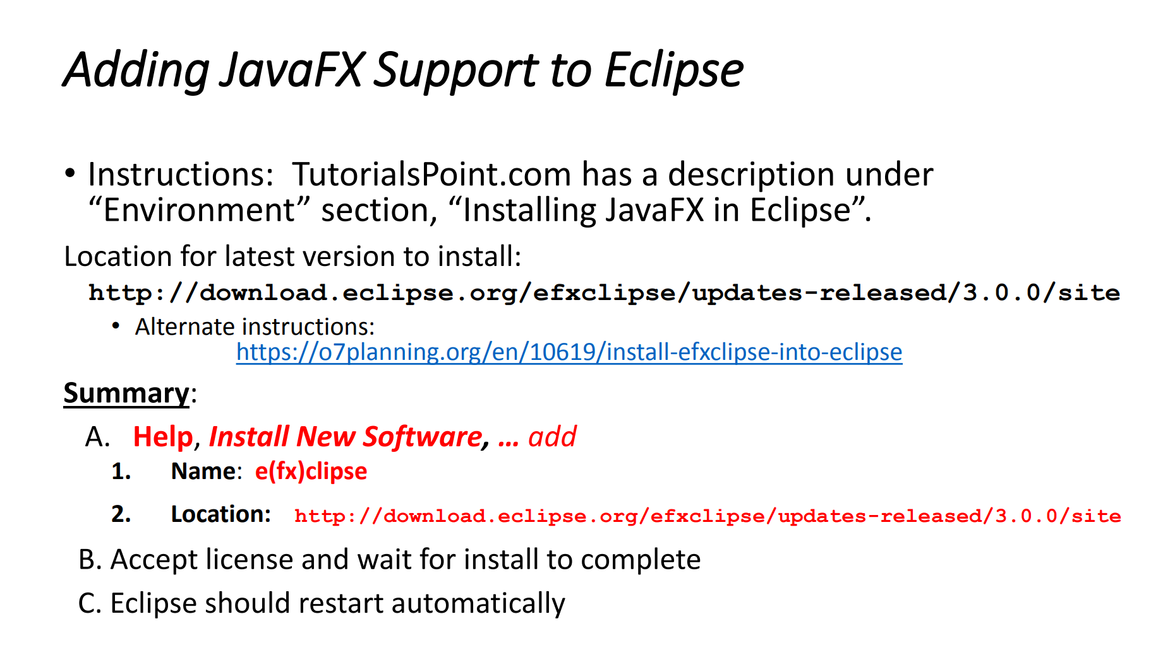
Setting up Eclipse

Slide 3
JavaFX GUIs Part 1: Launching
Notes:
Replace this with your course title and your name/contact details.

Slide 4
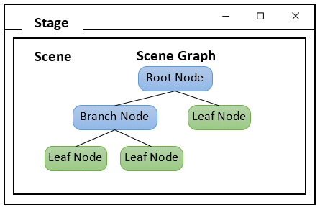
Layout Components
The user interface elements of a JavaFX program are arranged in a hierarchy of containers.
At the highest level is a stage, which represents a window.
Within the stage is a scene, which contains user interface controls.
The scene is set with a root node, which is generally a layout pane
The controls themselves (such as buttons, labels, drop-down lists, and so on) are usually contained in one or more layout panes that govern the positional layout of the controls.

Slide 5
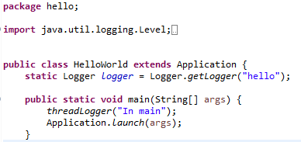
How a JavaFX Application Works (1)
The Application class is responsible for managing the lifecycle of a JavaFX application. The lifecycle consists of the following steps that are executed by the JavaFX runtime:
Create an instance of the Application class with a main method that calls Application.launch()
Imports go here. You will need javafx imports. I have also added optional java.util.logging imports

Slide 6
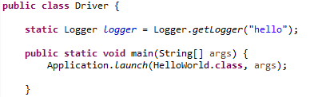
If your GUI is “the main event,” that is fine, but you can also launch from a Driver
Here the Driver calls Application.launch(), but passes it the class of the JavaFX application.
Obviously, the HelloWorld class in this case would not have a main() method.

Slide 7


How a JavaFX Application Works (2)
Call the init method. for any needed pre-processing The default implementation of the init method does nothing, but can be overridden to provide any processing you want to be performed before the application’s user interface displays.
The concrete, but empty, method init in the Application class

Slide 8
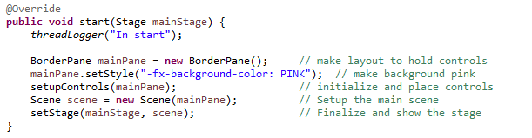
How a JavaFX Application Works (3)
Call the start method. for building and displaying the user interface Note
The start() method should be treated like the main method – i.e., it should not be very long. It should leverage private static methods to do the work.
Start is an abstract method in Application, and thus must be overridden and provided a method body.

Slide 9
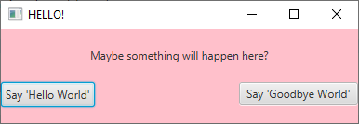
How a JavaFX Application Works (4)
Wait for the application to end,
closing the main application window or
choosing the program’s exit command.
During this time, the application isn’t really idle, but busy performing actions in response to user events, such as clicking a button or choosing an item from a drop-down.

Slide 10


How a JavaFX Application Works (5)
Call the stop method. for any needed post-processing like closing databases or saving files
The concrete, but empty, method stop in the Application class

Slide 11
How a JavaFX Application Works (5)
The Application class is responsible for managing the lifecycle of a JavaFX application. The lifecycle consists of the following steps:
Create an instance of the Application class with a main method that calls Application.launch()
Call the init method. for any needed pre-processing The default implementation of the init method does nothing, but can be overridden to provide any processing you want to be performed before the application’s user interface displays.
Call the start method. for building and displaying the user interface
Wait for the application to end,
closing the main application window or
choosing the program’s exit command.
During this time, the application isn’t really idle, but busy performing actions in response to user events, such as clicking a button or choosing an item from a drop-down.
Call the stop method. for any needed post-processing like closing databases or saving files

Slide 12

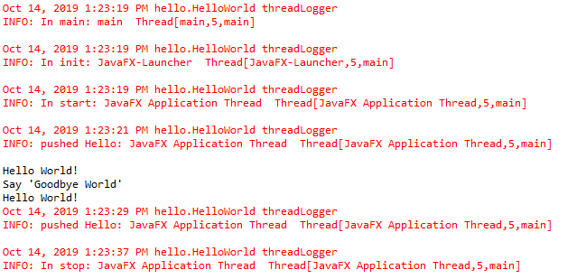
About those threads
Sequence
main()
init()
start()
Wait for application to end
stop()
Init() through stop() all on special JavaFX thread

Slide 13
JavaFX GUIs Part 2: Setting Up Controls
Notes:
Replace this with your course title and your name/contact details.

Slide 14
Layout Components
The user interface elements of a JavaFX program are arranged in a hierarchy of containers.
At the highest level is a stage, which represents a window.
Within the stage is a scene, which contains user interface controls.
The scene is set with a root node, which is generally a layout pane
The controls themselves (such as buttons, labels, drop-down lists, and so on) are usually contained in one or more layout panes that govern the positional layout of the controls.

Slide 15
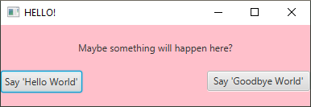

Hello World
Stage
Scene
Top
Maybe something will happen here?
root Node of
the Scene
Label, which is-a Control, which is-a Node
positioned in the Top
Left
Center
Right
Bottom
Button, which is-a Control, which is-a Node
positioned in the Left

Slide 16
Setting Up the Controls
private void setupControls(BorderPane mainPane) {
Label lbl = new Label("Maybe something will happen here?");
lbl.setPadding(new Insets(20));
Button btn1 = new Button();
btn1.setText("Say 'Hello World'");
Button btn2 = new Button();
btn2.setText("Say 'Goodbye World'");
// Now add to border
BorderPane.setAlignment(lbl,Pos.CENTER);
mainPane.setTop(lbl);
mainPane.setLeft(btn1);
mainPane.setRight(btn2);
mainPane.setBottom(new Label(" ")); //cheap way to get space
}

Slide 17
Setting the Stage
private void setStage(Stage mainStage, Scene scene) {
mainStage.setWidth(400);
mainStage.setTitle("HELLO!");
mainStage.setScene(scene);
mainStage.show();
}

Slide 18

Setting the Stage (1)
The Stage class is the top level JavaFX container. The primary Stage is constructed by the platform. Additional Stage objects may be constructed by the application.
Style
StageStyle.DECORATED - a stage with a solid white background and platform decorations.
StageStyle.UNDECORATED - a stage with a solid white background and no decorations.
StageStyle.TRANSPARENT - a stage with a transparent background and no decorations.
StageStyle.UTILITY - a stage w/solid white background and minimal platform decorations.

Slide 19
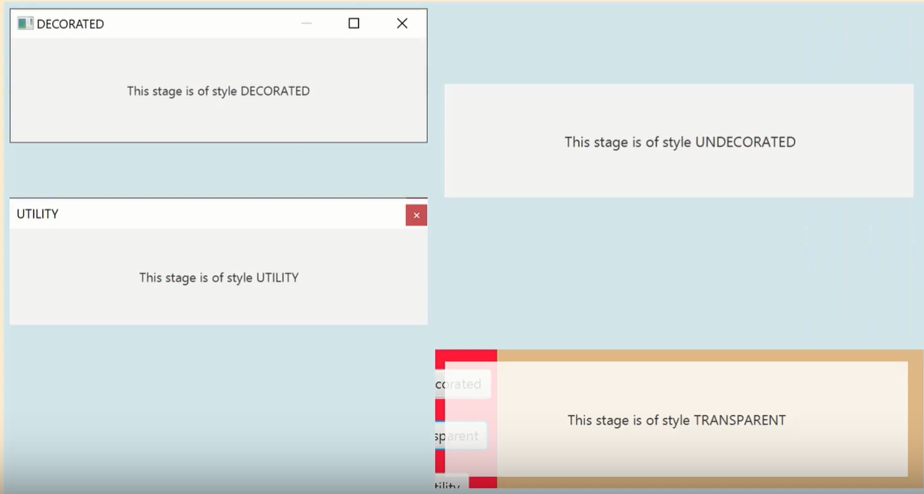
Stage Styles

Slide 20
Setting the Stage (2)
Owner
A stage can optionally have an owner Window as a “parent”
When a parent window is closed, all its “children” windows close. A stage will always be on top of its parent window.
Modality
Modality.NONE - a stage that does not block any other window.
Modality.WINDOW_MODAL - a stage that blocks input events from being delivered to all windows from its owner (parent) to its root. Its root is the closest ancestor window without an owner.
Modality.APPLICATION_MODAL - a stage that blocks input events from being delivered to all windows from the same application, except for those from its child hierarchy.

Slide 21
Modal vs Non-modal Windows
Modal dialogs block all other interaction.
Forces a response from the user
User must deal with the dialog before continuing with the program
Non-modal dialogs allow other interaction.
User can work with other components while the non-modal dialogs are open
This is sometimes desirable
May be difficult to avoid inconsistencies

Slide 22
Other Stage Methods
Method
close()
setFullScreen(boolean)
setIconified(boolean)
setMaximized(boolean)
setMaxHeight(double) setMaxWidth(double) setMinHeight(double) setMinWidth(double)
setResizable(boolean)
showAndWait()
toFront() toBack()

Slide 23
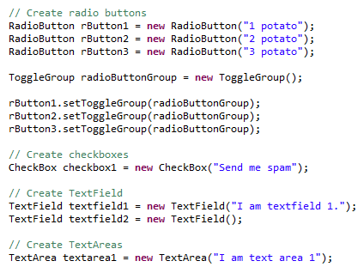




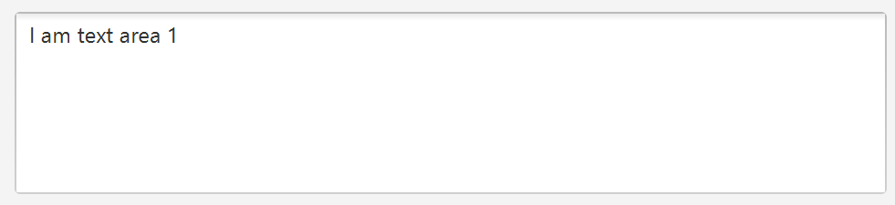
Other Controls (1)

Slide 24
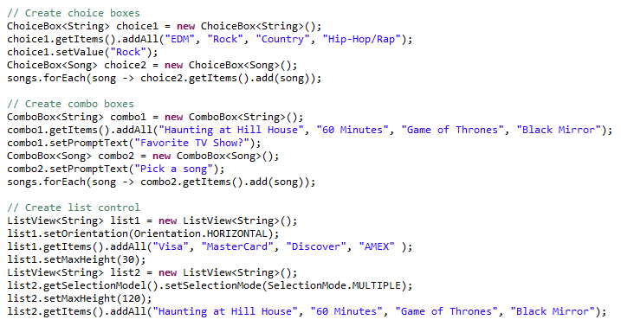

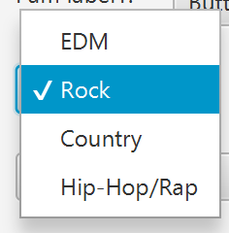
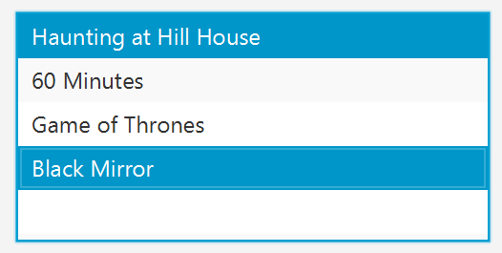

Other Controls (2)

Slide 25
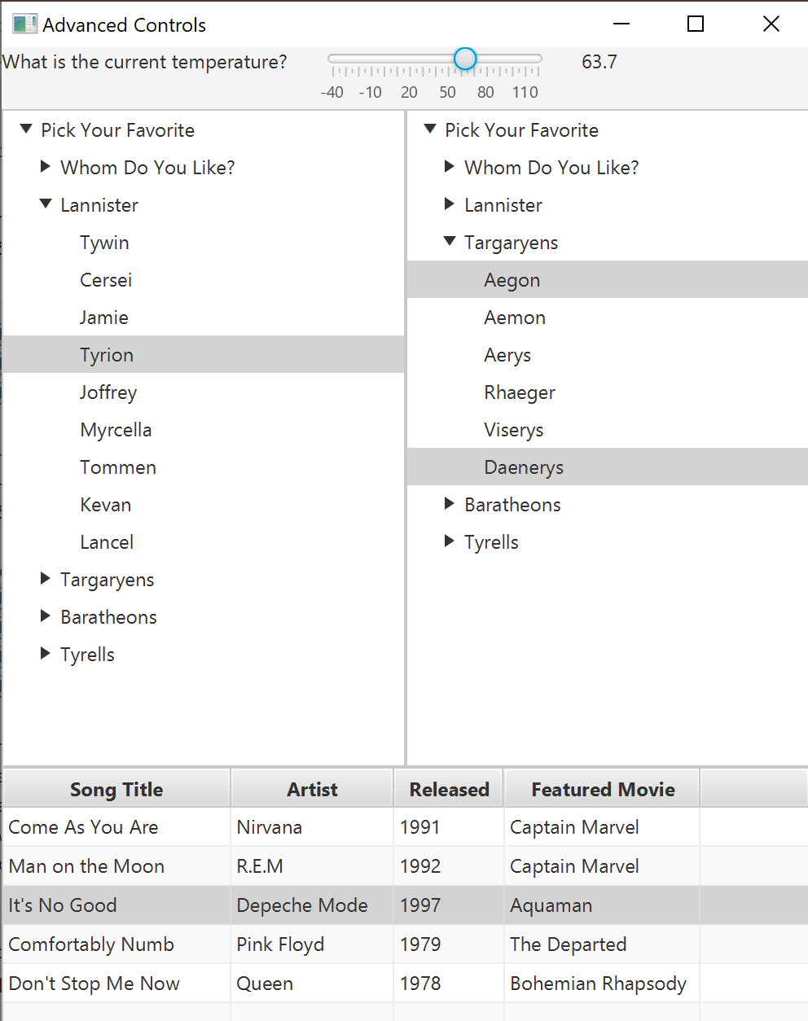

Advanced Controls
Slider
TreeView (single select)
TreeView (multi-select)
TableView

Slide 26
JavaFX GUIs Part 3: Event Handling
Notes:
Replace this with your course title and your name/contact details.

Slide 27
Hello World
Stage
Scene

Slide 28


Event Driven Programming
I just heard a button click.

Slide 29
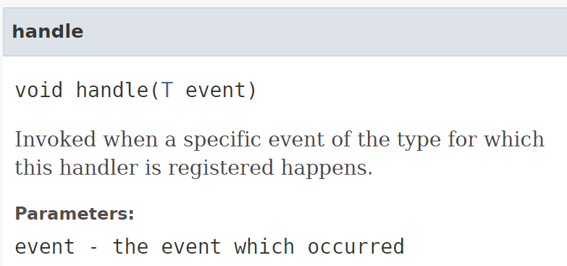
Event Driven Programming
Programs that operate in a GUI environment must be event-driven.
An event is an action that takes place within a program, such as the clicking of a button.
Event source: The control on which the event initially occurred.
Event handler: The object that listens for events and handles them when they occur. The event-listener object must implement the EventHandler interface, which defines a single method named handle()..
EventHandler
Functional Interface
Event

Slide 30
Commonly Used Events
Event Class | Package | Description
ActionEvent | javafx.event | Created when the user performs an action with a button or other component. Usually this means that the user clicked the button, but the user can also invoke a button action by tabbing to the button and pressing the Enter key. This is the most commonly used event class, as it represents the most common types of user-interface events.
InputEvent | javafx.scene.input | Created when an event that results from user input, such as a mouse or key click, occurs.
KeyEvent | javafx.scene.input | Created when the user presses a key on the keyboard. This event can be used to watch for specific keystrokes entered by the user.
MouseEvent | javafx.scene.input | Created when the user does something interesting with the mouse, such as clicking one of the buttons, dragging the mouse, or simply moving the mouse cursor over another object.
TouchEvent | javafx.scene.input | Created when a user initiates a touch event on a device that allows touch input
WindowEvent | javafx.stage | Created when the status of the window (stage) changes.

Slide 31
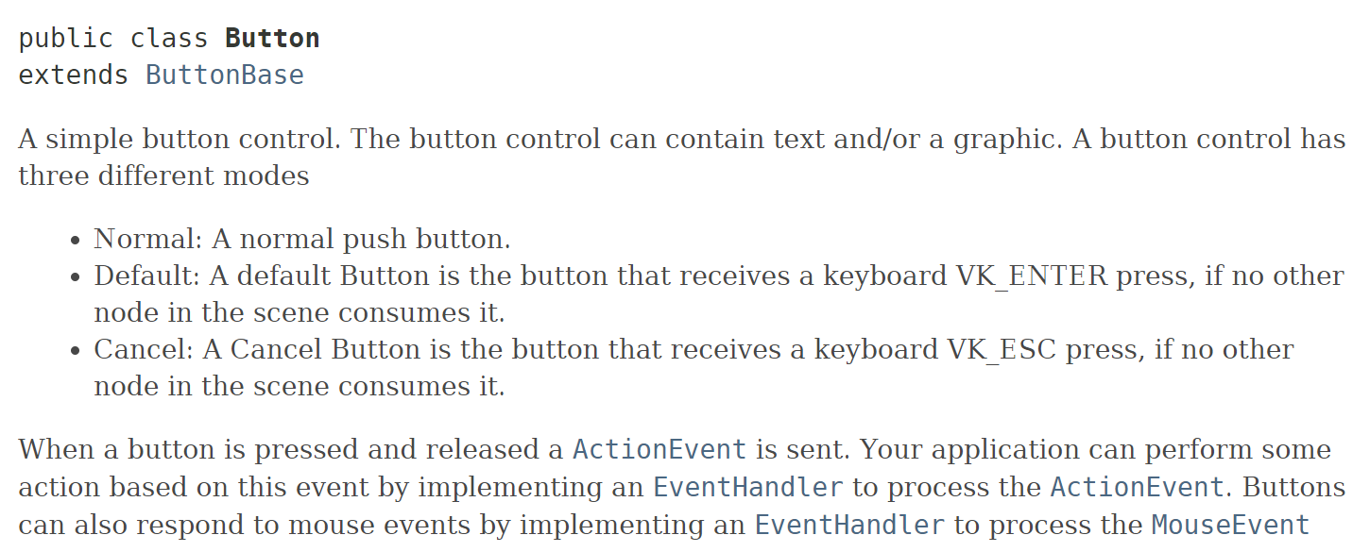
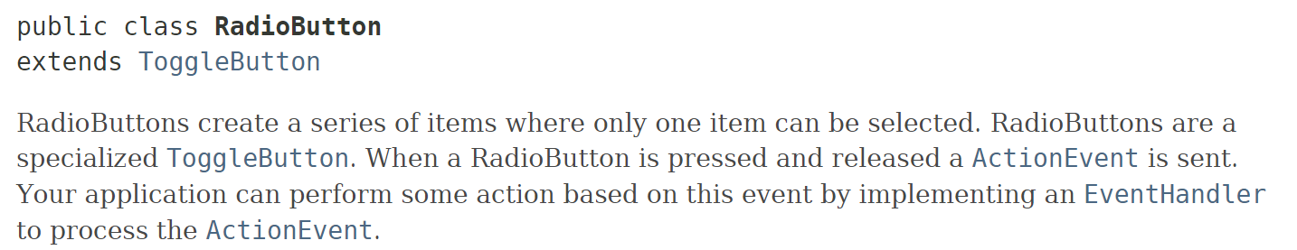
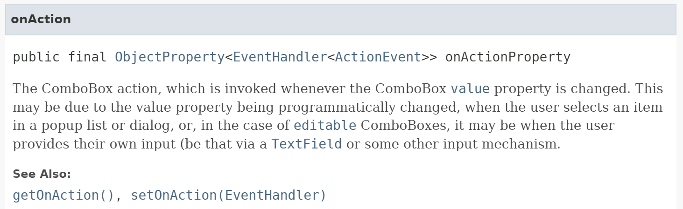



Action Events in Action

Slide 32
Setting Up the Controls
private void setupControls(BorderPane mainPane) {
Button btn1 = new Button();
btn1.setText("Say 'Hello World'");
btn1.setOnAction(new EventHandler<ActionEvent>() {
@Override
public void handle(ActionEvent event) {
System.out.println("Hello World!");
}
});
Button btn2 = new Button();
btn2.setText("Say 'Goodbye World’”);
btn2.setOnAction(e -> System.out.println( ((Button) e.getTarget()).getText()));
}

